Slide 1

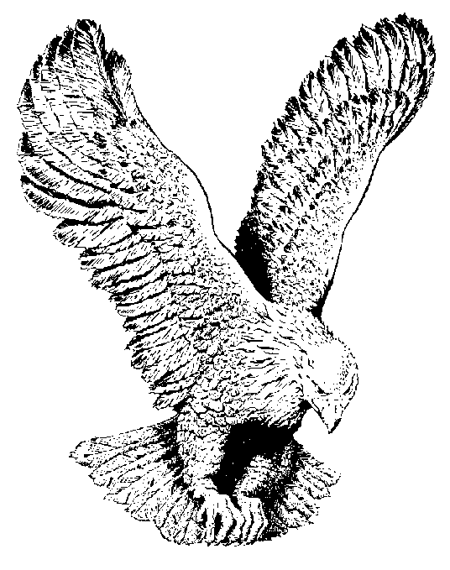
ABSOLUTELY FREE
Jesus set me free, absolutely free,
Died on Calvary, gave me liberty,
Jesus set me free, absolutely free,
Praise His Holy Name.

